Slide 1

Introduction to Data & the Logic of Inference
Mikołaj Wieczór, M.A.
Faculty of Psychology and Cognitive Science, AMU Poznan

Slide 2
Why Data? Why Numbers?
Real-world decisions often involve uncertainty
Data provides evidence to reduce uncertainty
Examples: court verdicts, medical diagnoses, policy decisions
Quantitative methods make findings traceable and transparent

Slide 3

Types of Data
Quantitative Data: Numerical values (e.g., age, test scores, reaction times)
Qualitative Data: Categorical values (e.g., gender, diagnosis, interview themes)
Subtypes: Nominal, Ordinal, Interval, Ratio
What kinds of quantitative and qualitative date can you identify in your discipline?

Slide 4
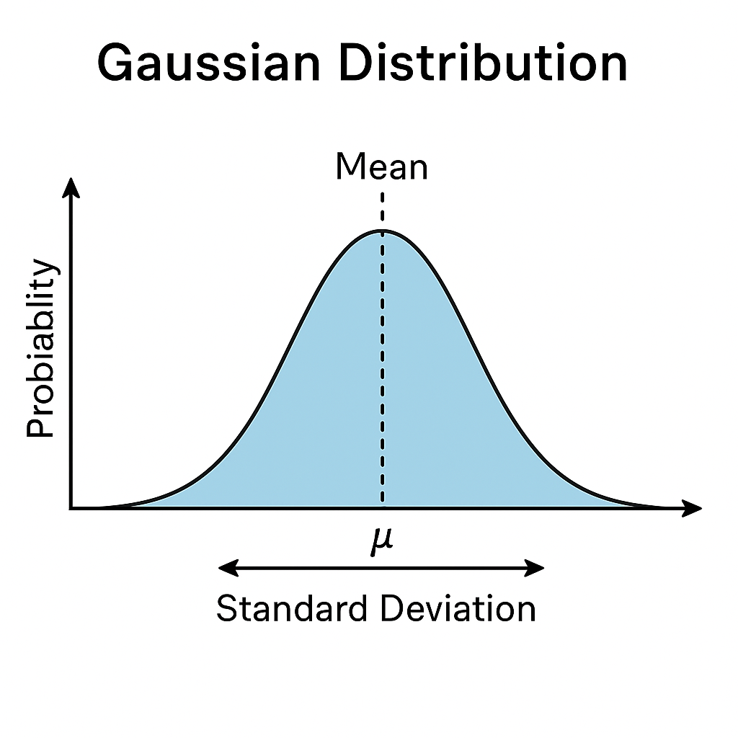
Variability in the Population
Individuals differ in traits and behaviors
Example: Distribution of intelligence (IQ) in population
Most traits approximate a Normal (Gaussian) distribution
Mean and Standard Deviation define the center and spread

Slide 5
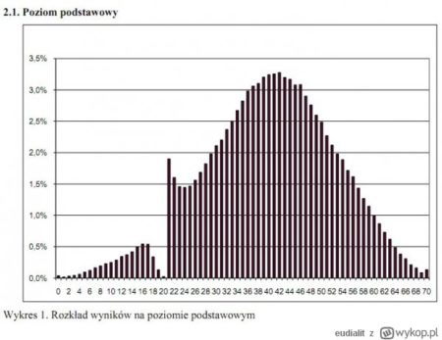
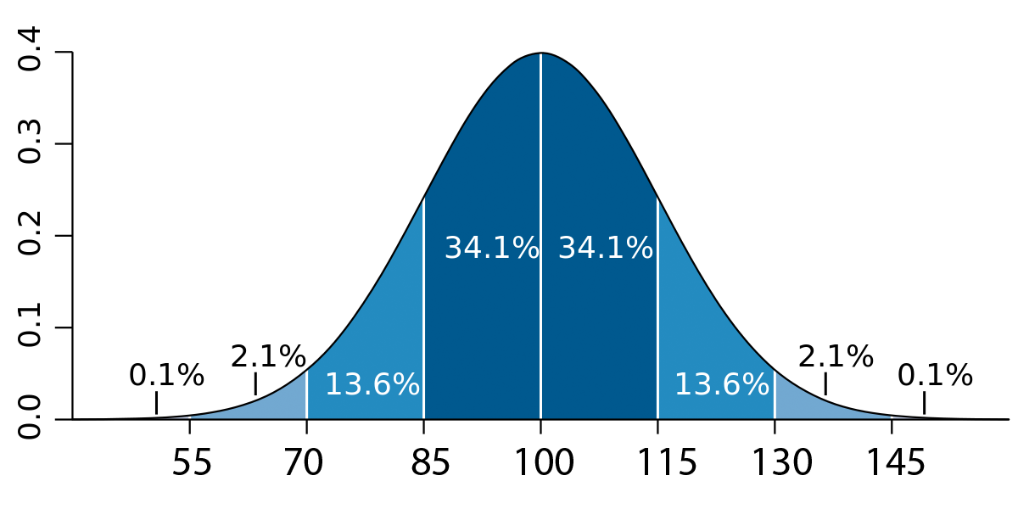
Gaussian Distribution
• Most observations cluster around the mean
• Fewer people at extremes
Standard Deviation (SD)
Mean (M)

Slide 6

From Sample to Population
We study samples because the full population is often inaccessible
Sample statistics estimate population parameters
Sampling error: Differences between sample and population by chance
Confidence Intervals: Range where the true population value likely lies
Statistical Significance: Is an observed difference too big to be chance?

Slide 7
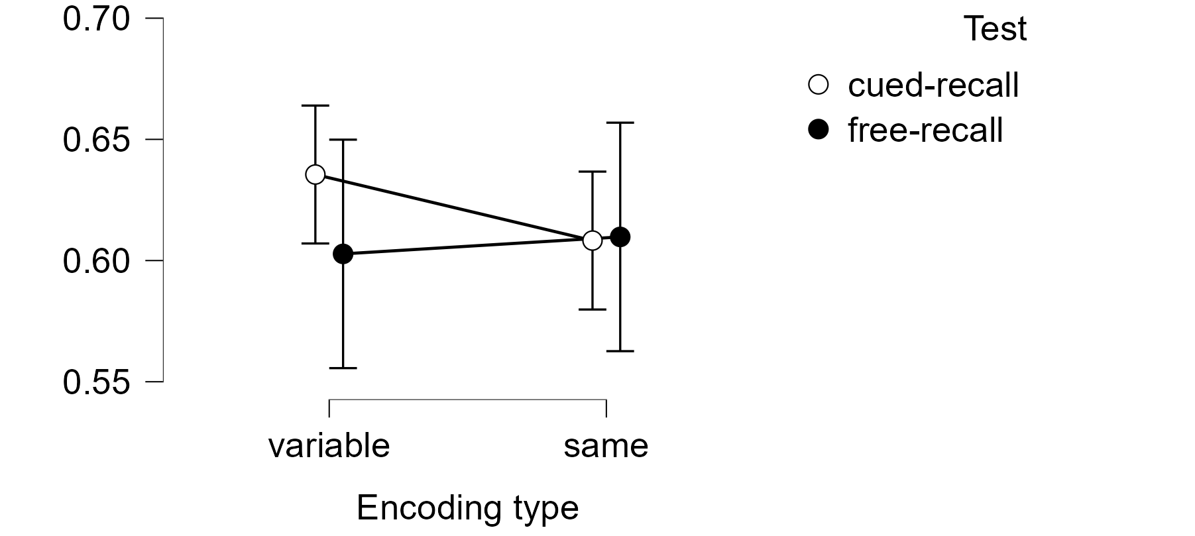
Visualizing Confidence Interval
• Error bars show uncertainty around estimates
• Narrow intervals: more precise estimates
• Wider intervals: less certainty
• p-values: is something different or is it a chance?
p < 0,5 significant result!
p > 0,5 no significance ☹
Error bars

Slide 8
Experimental Design Basics
Control Group vs. Experimental Group
Independent Variable (IV)
what we can manipulate, and we hope that is will change DV
vs. Dependent Variable (DV)
what we measure, the outcome from a participant
Within-Subjects vs. Between-Subjects Designs
Random Assignment ensures groups are comparable
Example: Testing memory with vs. without mnemonic technique

Slide 9
Testing memory with vs. without mnemonic technique
Task: learn list of 20 words in 3 minutes
Test: write down all words you remember
Group 1: just read the words and try to memorize them
Group 2: try to create a story containing words from list
Result: mean number of words form list recalled for each group
Try to answer:
Is it between or within-participant design?
What is dependent and independent variable?
Which group is control and which is experimental?

Slide 10
(De)constructing Experiment
Scenario: A study tests whether a reminder (“take your time”) improves eyewitness identification accuracy.
• What should be measured?
• What design (within or between participant) would you choose?
• What is the IV? • What is the DV?
• Which condition would serve as control?
Discuss with each other and share answers.

Slide 11

Distributions & Overlap
Comparing two groups often involves overlapping distributions
Example: Guilty vs. Innocent distributions of 'nervousness' scores
Overlap creates decision uncertainty: where to draw the cutoff?
This overlap problem leads directly to Signal Detection Theory

Slide 12
Visualizing Overlap
• Innocent and Guilty people scores distributions on the nervousness scale during interrogation
• Where to draw the threshold of nervousness that will tell us that someone is guilty?
Innocent distribution
Guilty distribution
Probability axis
Nervousness score

Slide 13
Wrap-Up & Key Takeaways
Data helps us reduce uncertainty in decisions
Different types of data require different approaches
Understanding distributions is crucial for inference
Samples provide insights, but with inherent uncertainty
Experimental design allows causal inferences by comparing groups’ means
Overlap in distributions introduce decisional problems – that Signal Detection Theory tries to overcome

